Slide 1
IoTrash
Group 5: Jane Coralde, Zainab Rehan, Ramin Sami, Amin Khakpour

Slide 2
Introduction
An overflowing trash can not only be aesthetically unpleasant, it could also be a health hazard for communities
IoTrash is a smart device that solves the problem of an overflowing trash can
We have designed a device that can measure the capacity of a trash can as it’s being filled up
A great way to track amount of trash a household goes through.

Slide 3
Implementation
Our device includes
An Ultrasonic sensor attached in lid of trash can to calculate trash(level).
NodeMCU Wifi-Module is the base controller.
Message alert system will be implemented using MQTT Protocol.
Continuous data collection and sending data in the cloud
Notes:
We are also collecting and updating continuous data for our user and storing it in the cloud

Slide 4
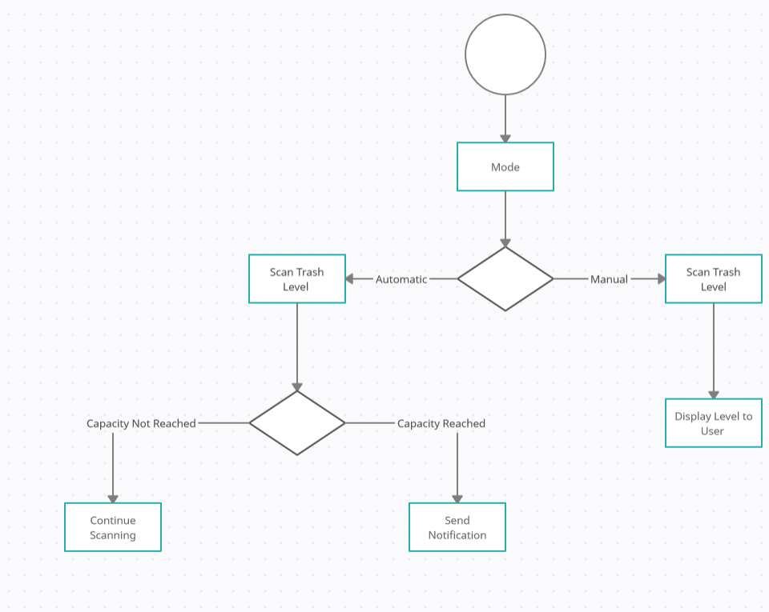
Flow
Notes:
Looking at the workflow you can see that our model follows an automatic mode which detects your trash can capacity at intervals and notifies you accordingly and manual mode which essentially lets the user check the capacity of the trash with the help of the app

Slide 5
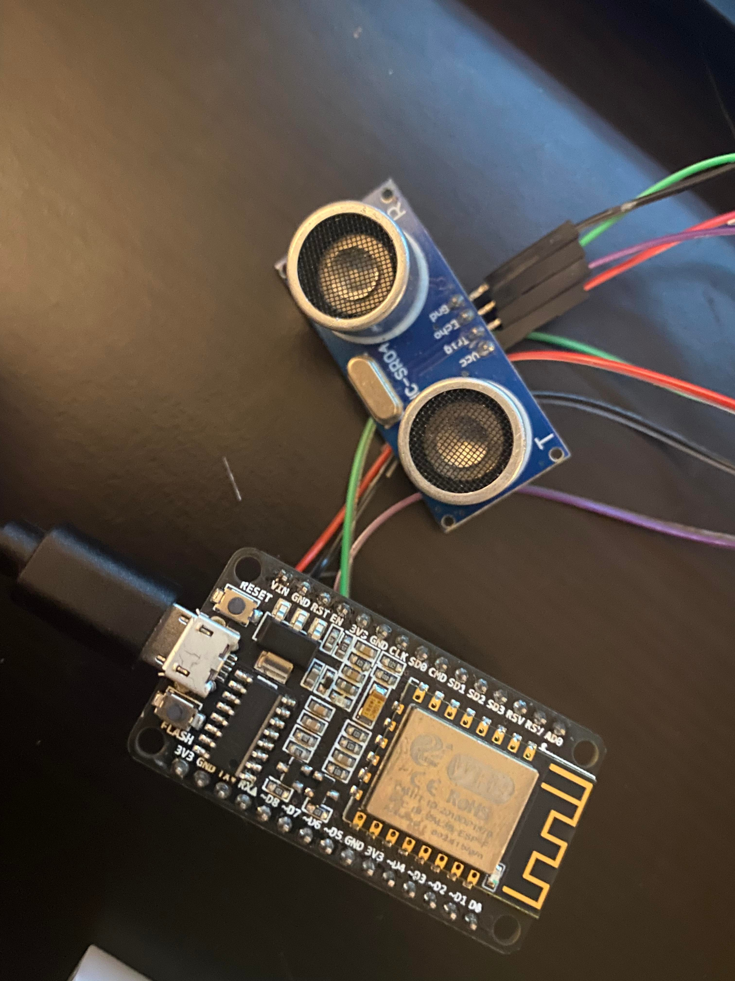
Implementation Continued
Ultrasonic sensor attached to the microcontroller
Sends out a pulse and receives it
Connects to broker (in Raspberry Pi)

Slide 6
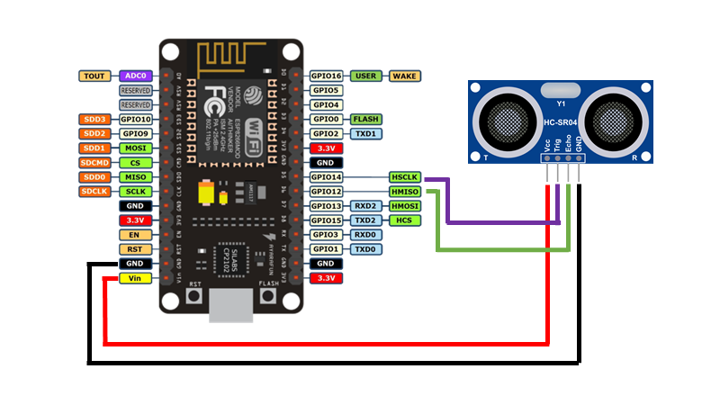
Notes:
Briefly talk about components and pins used
Jumper wires
NodeMCU
D5 and D6
Ports

Slide 7
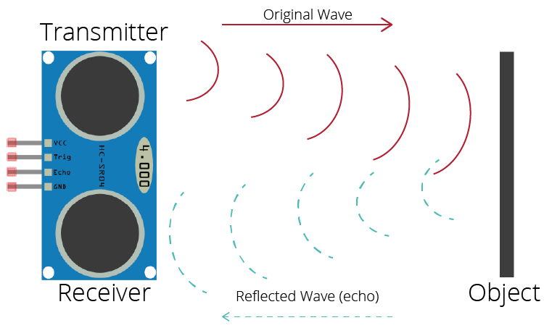
Notes:
How the ultrasonic sensor works and how its able to measure depth
D = 1/2 × T × C
where D is the distance, T is the time between the Emission and Reception, and C is the sonic speed.
(The value is multiplied by 1/2 because T is the time for go-and-return distance.)

Slide 8
Results

Slide 9
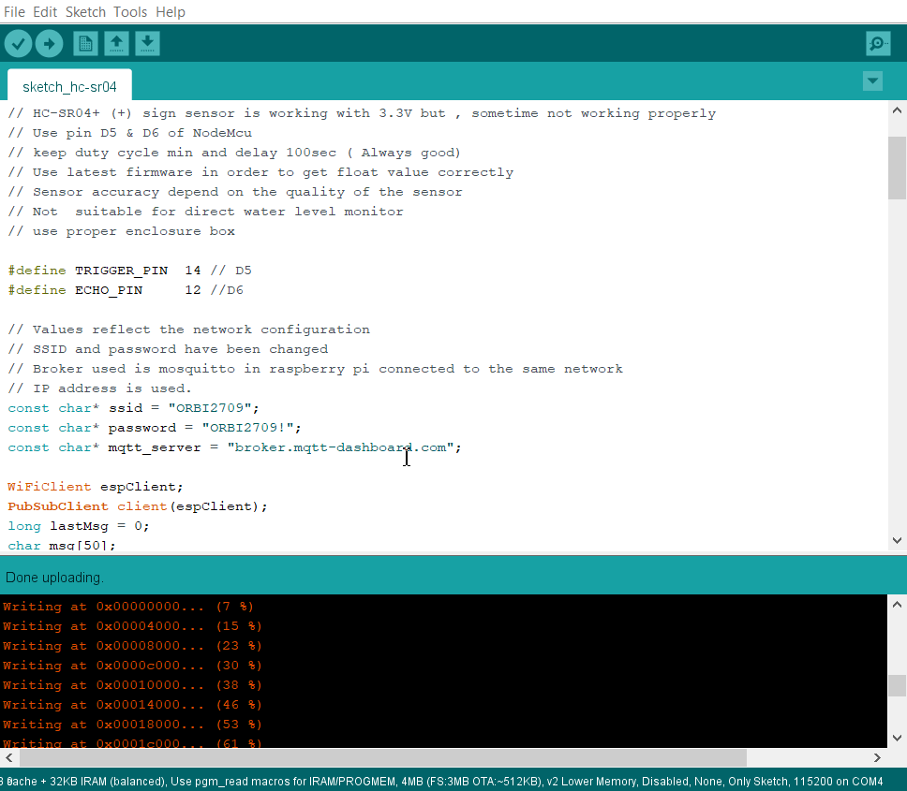
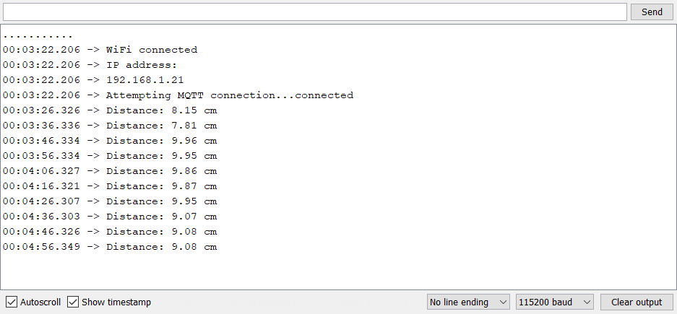

Slide 10
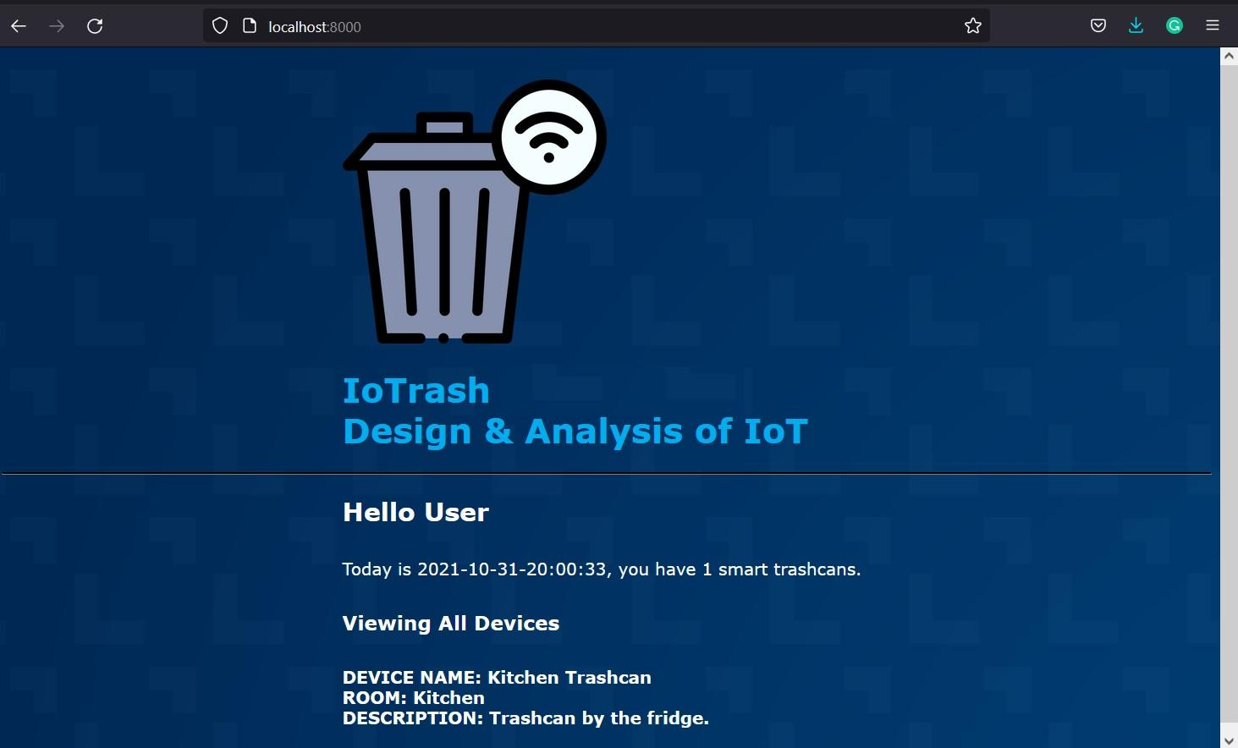

Slide 11
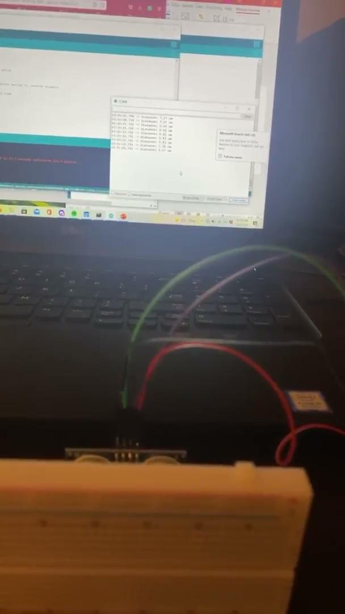

Slide 12
Future Work
How to power the device
Design case and wiring
Refine code

Slide 13
Thank you for listening

